Slide 1

IIT Kanpur – FY2014-15 summary financials
June 24, 2016

Slide 2
Non-Plan and Plan Expenditure (Rs. Crore)
Year | Non-Plan | Plan
2008-09 | 133.12 | 123.05
2009-10 | 171.98 | 97.06
2010-11 | 159.28 | 102.41
2011-12 | 175.94 | 149.00
2012-13 | 197.73 | 168.93
2013-14 | 221.45 | 260.98
2014-15 | 259.17 | 213.03

Slide 3
Non-Plan and Plan Expenditure (Rs. crore)

Slide 4
Funding of Plan and Non-Plan Expenditure

Slide 5
Student Numbers
Year | Student Nos.
2008-09 | 4,097
2009-10 | 4,426
2010-11 | 4,909
2011-12 | 5,311
2012-13 | 5,711
2013-14 | 6,167
2014-15 | 6,415

Slide 6
Student Numbers

Slide 7
Non-Plan & Plan Expenditure / Student (Rs.)
Year | Non-Plan | Plan | Total
2008-09 | 324,921 | 300,342 | 625,262
2009-10 | 388,568 | 219,295 | 607,863
2010-11 | 324,465 | 208,617 | 533,082
2011-12 | 331,275 | 280,550 | 611,825
2012-13 | 346,227 | 295,798 | 642,024
2013-14 | 359,089 | 423,188 | 782,277
2014-15 | 404,006 | 332,081 | 736,087

Slide 8
Non-Plan & Plan Expenditure / Student (Rs.)

Slide 9
Non-Plan Expenditure (Rs. crore)
Description | FY2012-13 | FY2013-14 | FY2013-14 Funded by:
 |  |  | Government Grant (Cash) | Government Grant (Receivable) | Internal Receipts
Salary | 96.66 | 96.86 | 96.60 | 0.26 | -
Pension | 44.66 | 49.89 | 46.83 | 3.05 | -
Others | 56.41 | 74.70 | 15.66 | - | 59.05
Total | 197.73 | 221.45 | 159.09 | 3.31 | 59.05

Slide 10
Non-Plan Expenditure (Rs. crore)
Description | FY2013-14 | FY2014-15 | FY2014-15 Funded by:
 |  |  | Government Grant (Cash) | Government Grant (Receivable) | Internal Receipts
Salary | 96.86 | 114.43 | 113.4800 | 1.21 | -
Pension | 49.89 | 52.82 | 53.0000 | 2.87 | -
Others | 74.70 | 91.92 | 26.2384 | - | 65.6816
Total | 221.45 | 259.17 | 192.7184 | 4.08 | 65.6816

Slide 11
Non-Plan Expenditure (Rs. crore)

Slide 12
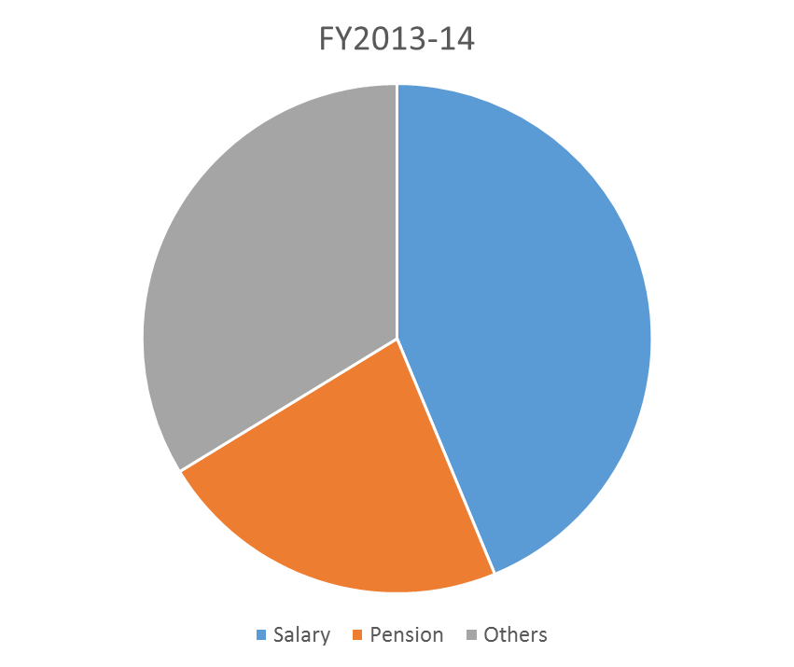
Non-Plan Expenditure (by type)

Slide 13
Non-Plan Expenditure (Others) (Rs. crore)
# | Description | FY2012-13 | FY2013-14 | FY2014-15
1 | Water & Electricity | 18.53 | 26.69 | 34.51
2 | Housekeeping & Maintenance | 11.90 | 17.60 | 21.14
3 | Hall Subsidy (including Mess Establishment Charge Receipts) | 11.57 (8.57) | 13.03 (10.04) | 13.95 (10.95)
4 | Department / Section Expenses | 8.63 | 9.59 | 7.70
5 | Administrative (Institute) Expenses | 3.61 | 4.22 | 3.92
6 | Computer Facilities | 1.10 | 2.16 | 3.06
7 | Student Support Services | 0.64 | 0.92 | 1.16
8 | Transport Subsidy | 0.44 | 0.49 | 0.59
9 | Research Activities (distinct element from FY2014-15) |  |  | 5.89
 | Total | 56.41 | 74.70 | 91.92

Slide 14
Internal Receipts (Rs. crore)
# | Description | FY2012-13 | FY2013-14 | FY2014-15
1 | Student Fees | 18.07 | 21.88 | 26.80
2 | Mess Receipts | 8.57 | 10.04 | 10.95
3 | R&D Savings | 0.66 | 8.28 | 11.96
4 | Interest Earnings from Endowment | 0.00 | 5.52 | 0.00
5 | Interest on Investments / Savings Bank | 0.70 | 3.44 | 0.81
6 | Electricity Charges Recovered | 1.97 | 2.85 | 3.18
7 | GATE / JMET / JAM Surplus | 2.00 | 2.00 | 3.00
8 | House Rent / Water Charges / Licence Fee / IWD Miscellaneous | 0.84 | 1.21 | 1.57
9 | Visitors’ Hostel | 0.83 | 1.16 | 1.72
10 | Equipment / Other Auction | 0.25 | 0.44 | 0.47
11 | Interest on Interest Bearing Advances | 0.13 | 0.07 | 0.10
12 | Others | 7.29 | 2.17 | 5.12
 | Total | 41.31 | 59.05 | 65.68

Slide 15
Plan Expenditure (Rs. crore)
Description | FY2012-13 (Actual) | FY2013-14 (Actual) | FY2014-15 (Actual) | FY2014-15 Funded by
Recurring | 30.00 | 44.00 | 37.5325 | Govt. Grant – Rs. 29.50 crore Internal sources – Rs. 8.0325 crore
Non-Recurring | 138.90 | 216.98 | 175.5000 | Govt. Grant – Rs. 175.5000 crore Internal sources – Nil
Total | 168.93 | 260.98 | 213.0325 | Govt. Grant – Rs. 205.00 crore Internal sources – Rs. 8.0325 crore

Slide 16
Plan Expenditure (by type) (Rs. crore)
Description | FY2012-13 (Actual) | FY2013-14 (Actual) | FY2014-15 (Projected) | FY2014-15 (Actual)
Buildings & Works | 76.11 | 67.08 | 185.00 | 104.02
Equipment | 57.30 | 148.67 | 86.85 | 56.65
Library Resources | 11.99 | 14.77 | 14.75 | 14.82
Scholarships / Assistantships & Others | 23.53 | 30.46 | 41.20 | 37.54
Total | 168.93 | 260.98 | 327.80 | 213.03

Slide 17
Plan Expenditure (Rs. crore)

Slide 18
Helpful Information
FY2014-15: 1 April 2014 to 31 March 2015
1 crore = 10 million
US$ 1 = Rs. 62.59 (approx.) as on 31 March 2015
MHRD: Ministry of Human Resource Development, Govt. of India
All students are full-time students.
Non-Plan expenditure refers to recurring (ongoing) expenses on salaries, pension, and other operating expenses.
Plan expenditure refers to expenditure on capital renewal and development, library resources, and scholarships.

Slide 19
Thank you

